Slide 1
FAST and IMAGE Coincident Viewing
11/10/16 Tagup

Slide 2
Ephem Status
FAST definitive Ephem provided by R. Strangeway
Time span: 1996 234 10:30:00.000 to 20090121 02:26:49.990
Down sampled orbital elements from 1/orbit to 1/day
SMA = 8300, ECC = 0.1898; INC = 82.97 (all the rest variable)
IMAGE definitive Ephem constructed piece-wise from data obtained from CDAWeb (http://cdaweb.sci.gsfc.nasa.gov/cgi-bin/eval2.cgi)
Time span: 3/27/2000 00:00:55.000 to 12/19/2005 23:58:00.000
Down sampled orbital elements from 1 per 2 min 1/day
SMA = 29,815.4; ECC = 0.7531; INC = 90.010 (all the rest variable)

Slide 3

Step 1 Filtering Strategy
Coincident observations can only occur when planes are nearly aligned
Determine alignment via the angle between their osculating angular momenta
FAST Orbit
L_{IMAGE}
L_{FAST}
IMAGE Orbit

Slide 4
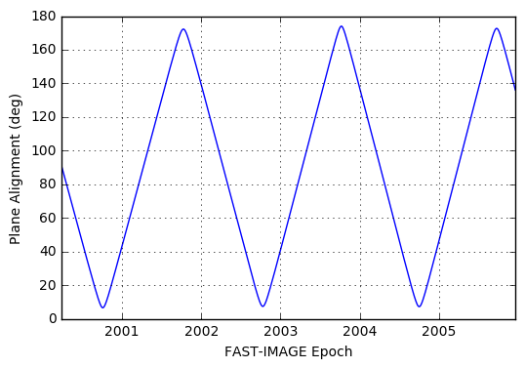
Step 1 Filtering Results
Plot shows the alignment angle as a function of time (still need to finish QA)
Assuming the planes should be aligned within 20 degrees gives 5 coincident time

